Slide 1
FUNDED PROFESSIONAL DEVELOPMENT ACTIVITIES, CONFERENCE FORMS
& ADOBE SIGN
Career Education & Workforce Development
Susana Cardenas

Slide 2
Purpose:
Requesting a Conference
Step-by-step explanation of the SAC & RSCCD conference request process from securing conference funds to obtaining necessary approvals to turning in your conference summary and receipts.
https://www.sac.edu/FacultyStaff/professional-development/Pages/Conferences.aspx

Slide 3
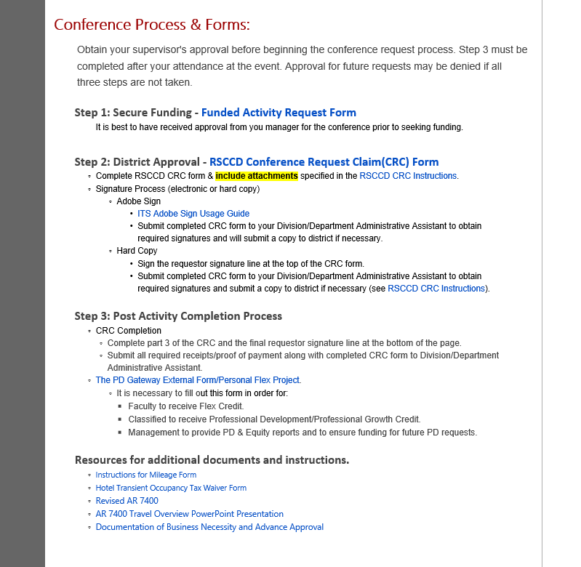

Slide 4
Conference/Webinar/Online Course/Training
Process: Overview
Complete RSCCD Form With Supporting Documents
Manager Approval and Area Vice President’s Approval
President Approval
Notification of Approval
Request For Advances/Arrange Conference Purchases
Conference Attendance
Conference Reimbursement Submission & Completion of
“Add External Training”
In Gateway
Direct Supervisor Signature
Accounts Payable Processing
Reimbursement Check issued
Secure Funding Source/Funding Source Manager Approval
Complete SAC Conference Funds Request Form

Slide 5

Before the Conference
Explore funding options for the c
SAC/SCE
Perkins (CTEA)
SWP (Strong Workforce Program)
SAC Professional Development/ Student Equity

Slide 6
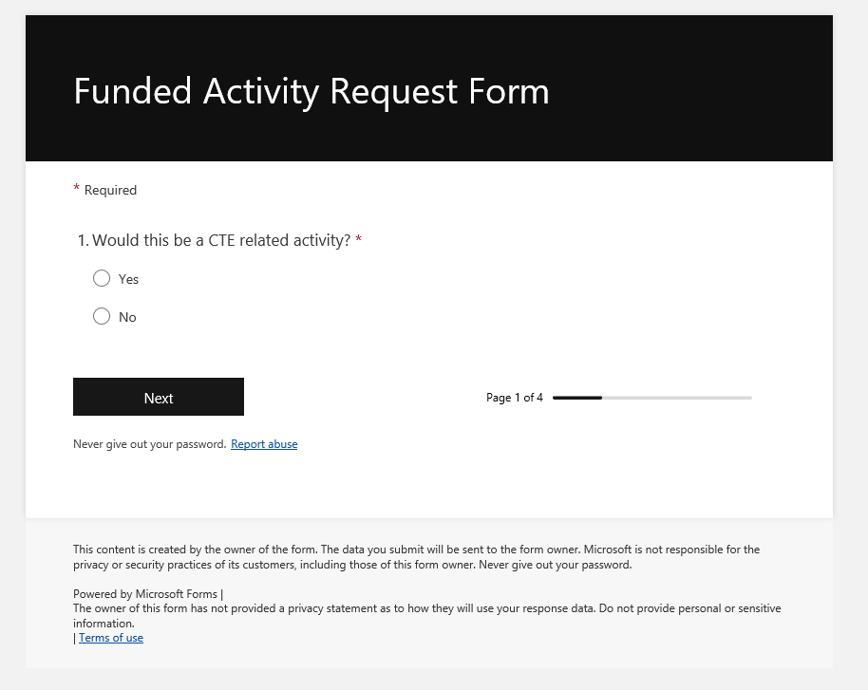

Slide 7
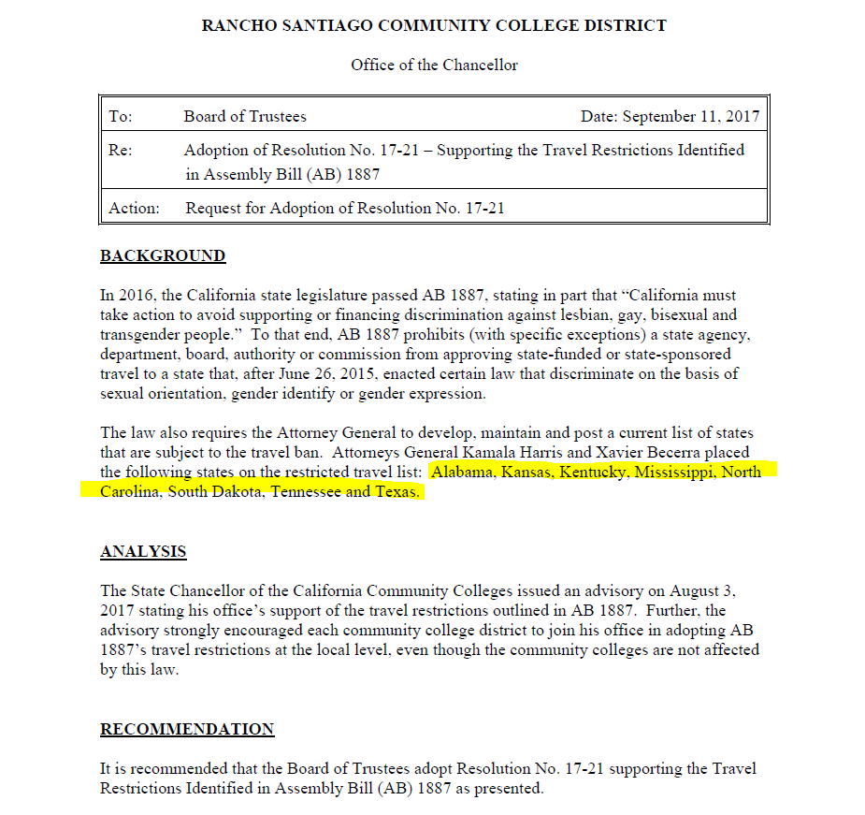
Travel Restrictions
The following states are on the restricted travel list:
Alabama
Idaho
Iowa
Kansas
Kentucky
Mississippi
North Carolina
Oklahoma
South Carolina
South Dakota
Tennessee
Texas NEW:
Arkansas
Florida
Montana
North Dakota
West Virginia
Attorney General Bonta to Add Five States to Travel Restrictions List as a Result of Wave of New Anti-LGBTQ+ Legislation | State of California - Department of Justice - Office of the Attorney General
PROHIBITION ON STATE-FUNDED AND STATE-SPONSORED TRAVEL TO STATES WITH DISCRIMINATORY LAWS (ASSEMBLY BILL NO. 1887) | State of California - Department of Justice - Office of the Attorney General

Slide 8
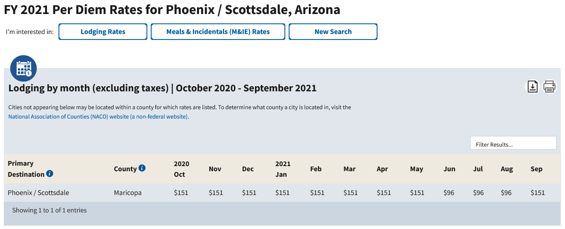
www.gsa.gov

Slide 9
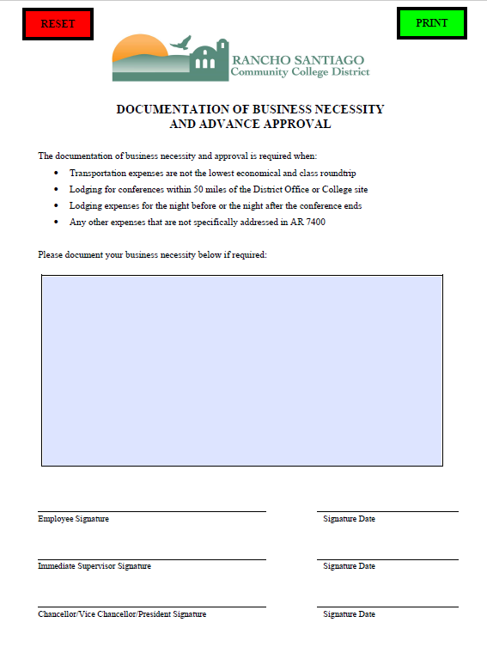

Slide 10
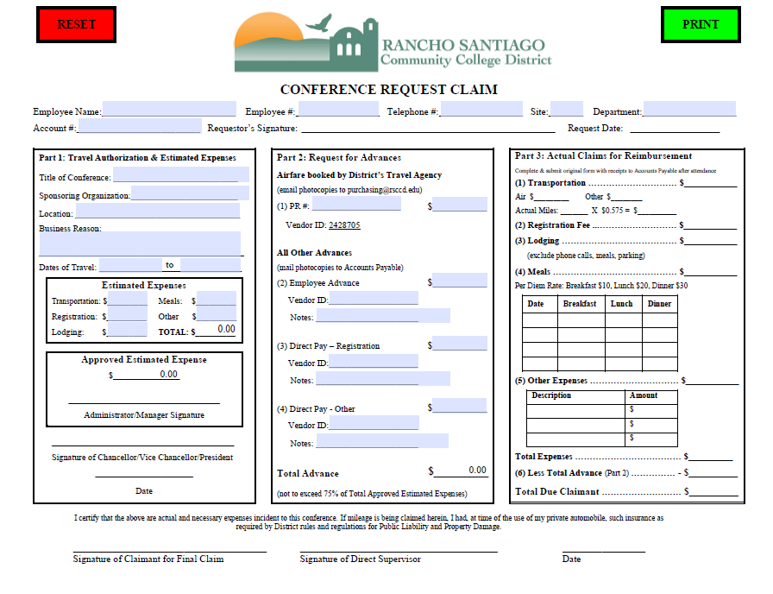

Slide 11
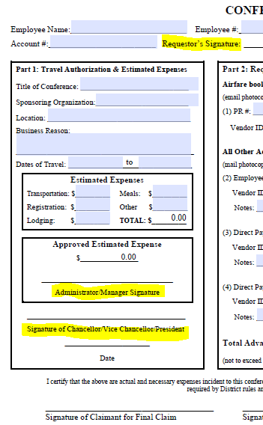
Part 1 : Travel Authorization & Estimated Expenses

Slide 12
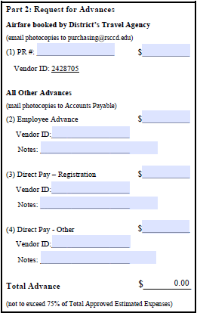
Part 2 : Request for Advances

Slide 13
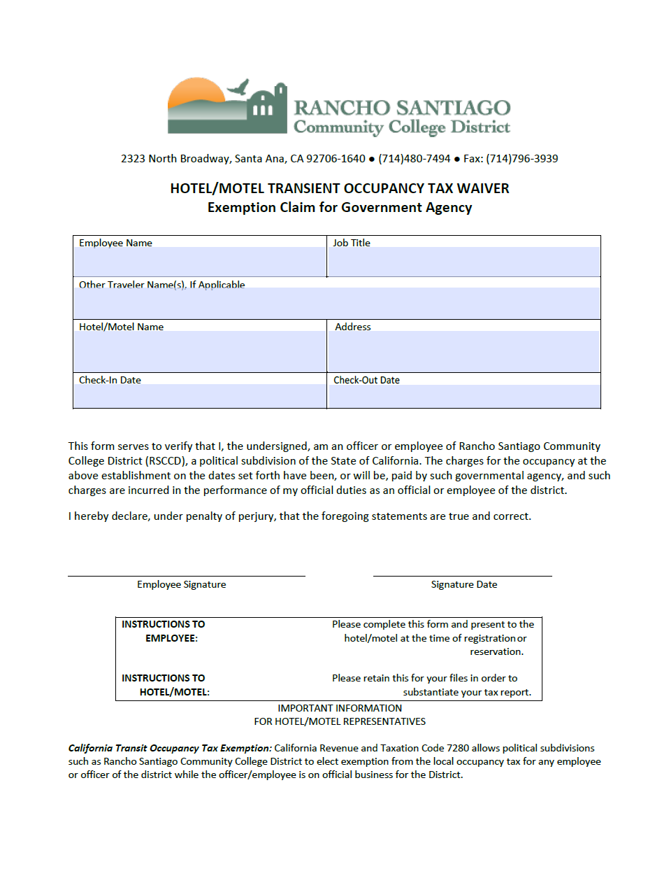
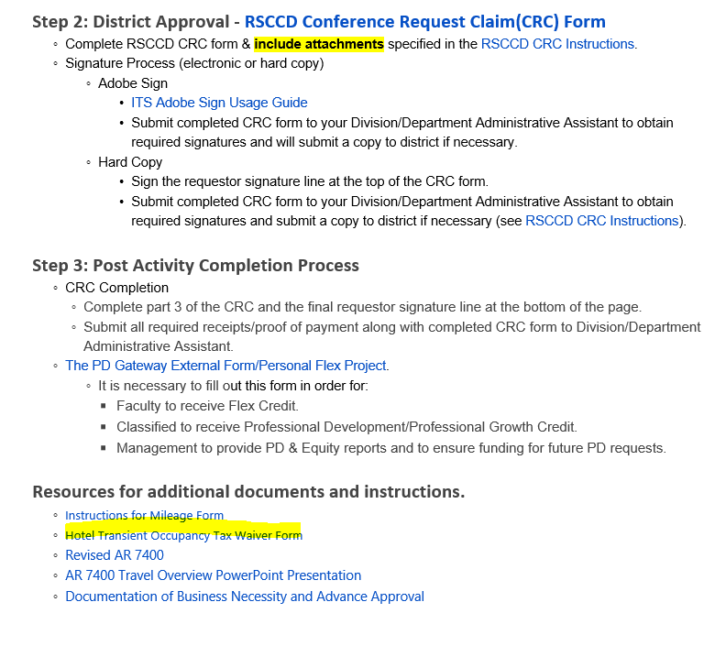
Hotel Tax
Waiver

Slide 14
After the Conference/Training
Complete Gateway “Add External Training”
Complete the RSCCD CRC Section 3
Obtain signatures

Slide 15


Slide 16
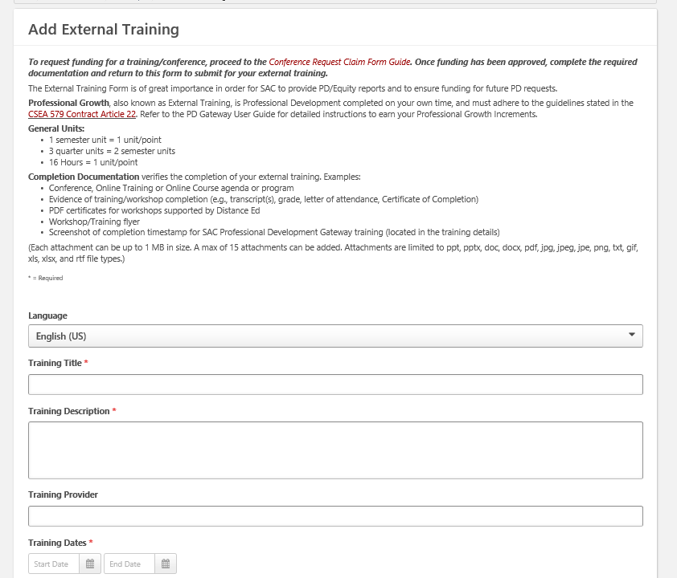

Slide 17
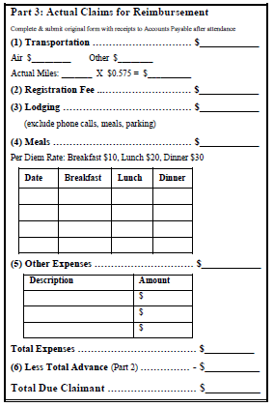
Part 3: Actual Claims for Reimbursement

Slide 18
Meals:
Standardized per diem rates
$10 for breakfast
$20 for lunch
$30 for dinner
We need the conference agenda attached. No reimbursements for meals included in the conference.

Slide 19
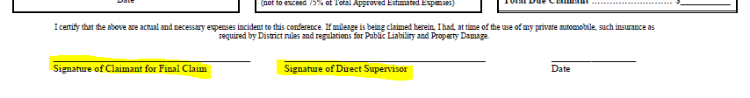
Obtain required signatures

Slide 20
Submit signed conference packet to RSCCD Accounts Payable
Accounts Payable

Slide 21
Putting your packet together, let’s do this…

